Slide 1
Evapotranspiration
Precipitation
ET_{max}= maximum evapotranspiration
γ_{p} = inverse mean of rainfall (cm⁻¹)
λ_{p} = frequency of rainfall (day⁻¹)
1
Soil
n = porosity
s_{w} = wilting point
s₁ = field capacity
Zr = root depth
Mass balance components
import
channel
2
Leakage
shallow aquifer
3
k = recession constant
deep groundwater
Baseflow
Shallow Aquifer
Channel
4
Groundwater recharge
Deep Groundwater

Slide 2
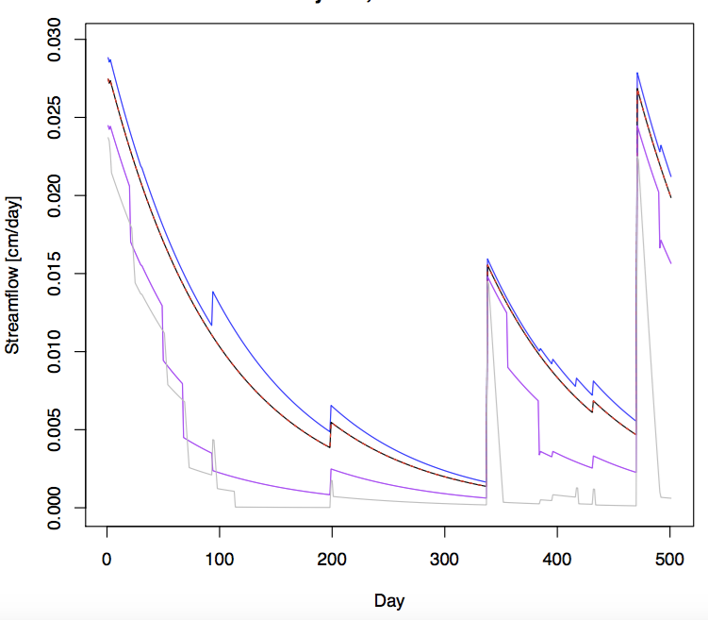
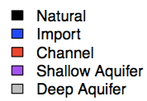
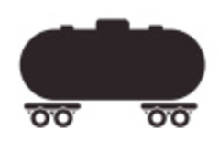


= average streamflow
α = average peak height
λ = average peak frequency

Slide 3


Slide 4


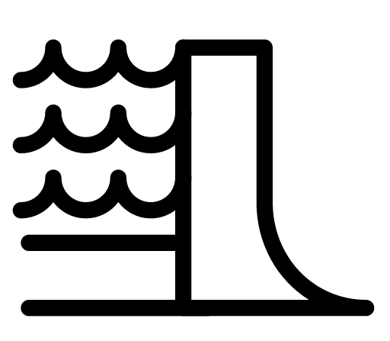
Q
Q
✔
✔
Q = ?
Q = ?
Traditional PUB
PUB in managed basins
irrigation
irrigation = ?
✔
✔
Q
Q = ?

Slide 5
Irrigation is needed but less than 50% is provided
Irrigation is not required
Metric cannot be evaluated; streamflow never peaks

Slide 6
Catchment 1
D1 = 2, D2 = 3
Aridity = 0.67
Catchment 2
D1 = 4, D2 = 34
Aridity = 1
Catchment 2
D1 = 4, D2 = 34
Aridity = 1
1
2
3
4
4
λ
α
Positive percent change
Negative percent change

Slide 7
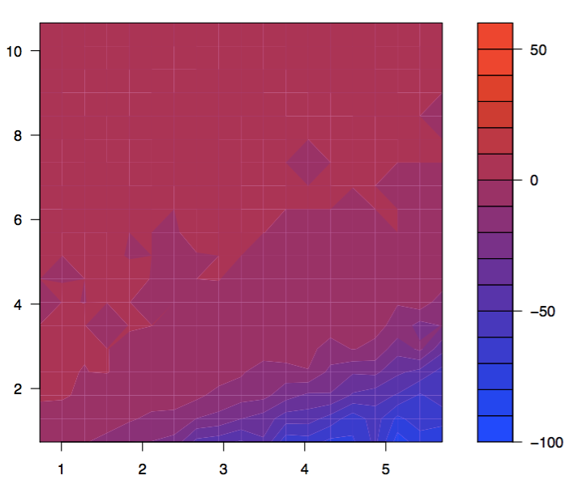
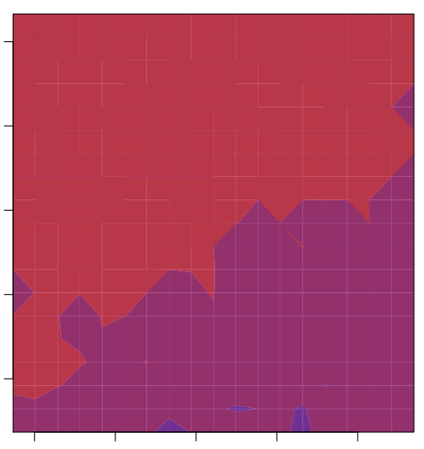

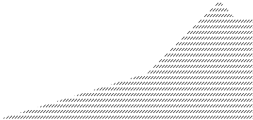
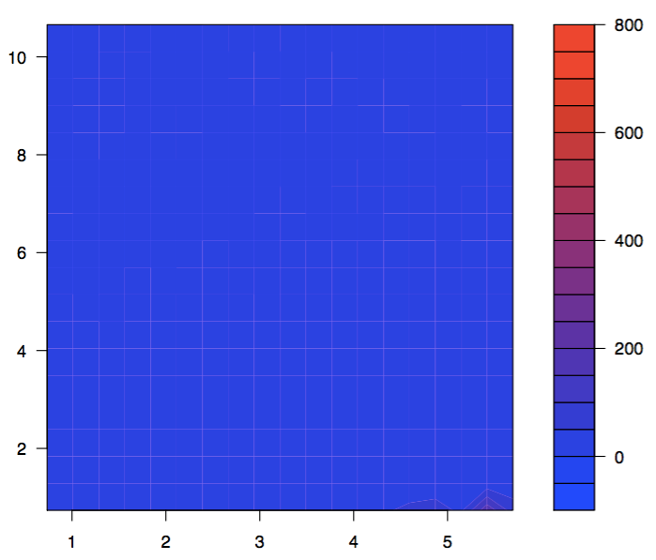
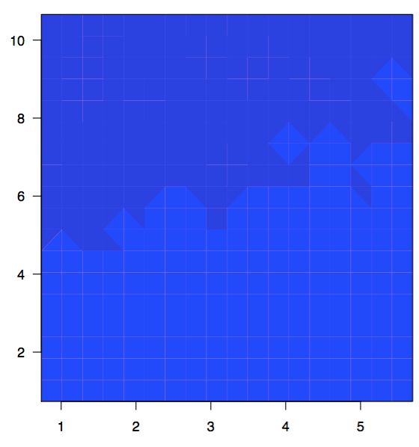

Slide 8
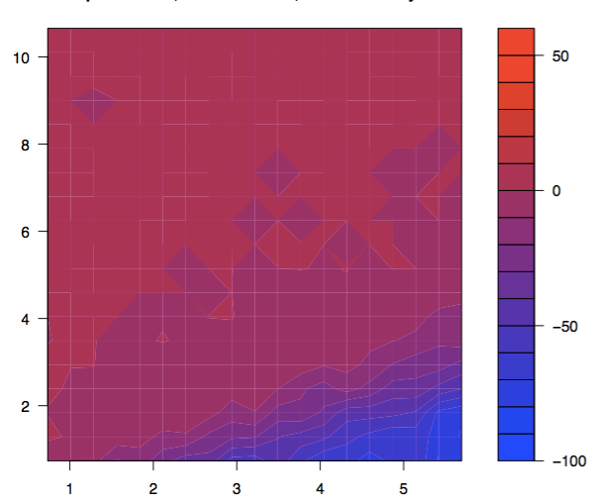
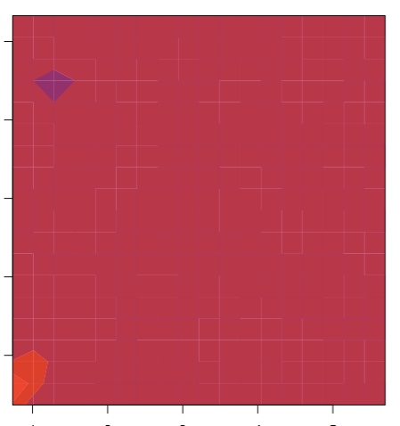
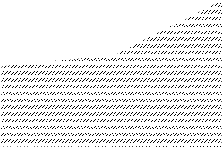
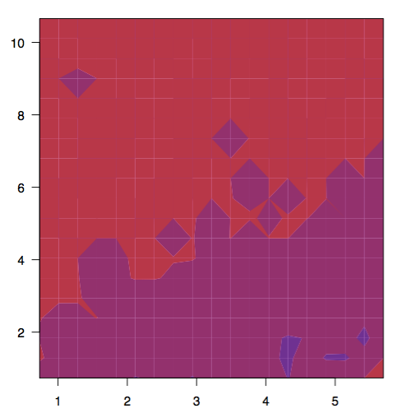
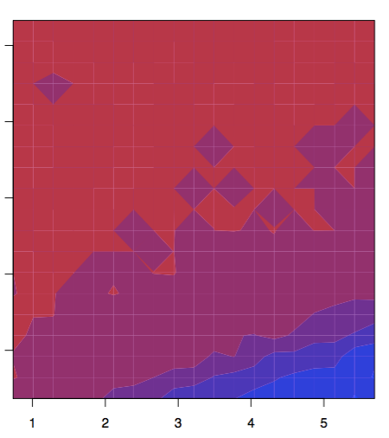

Slide 9
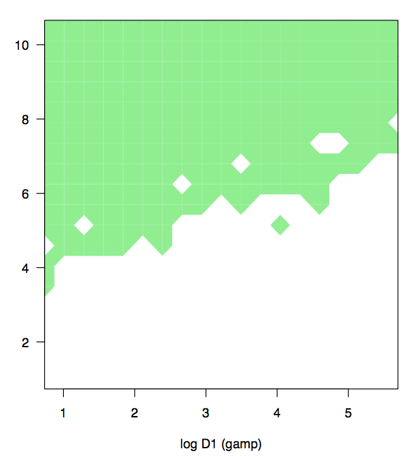
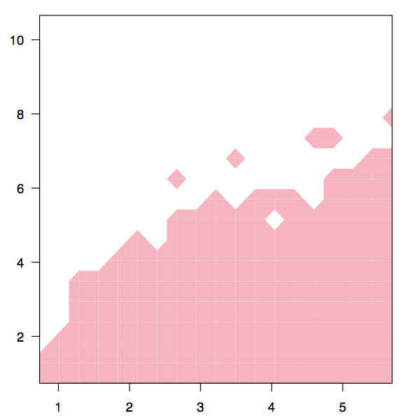
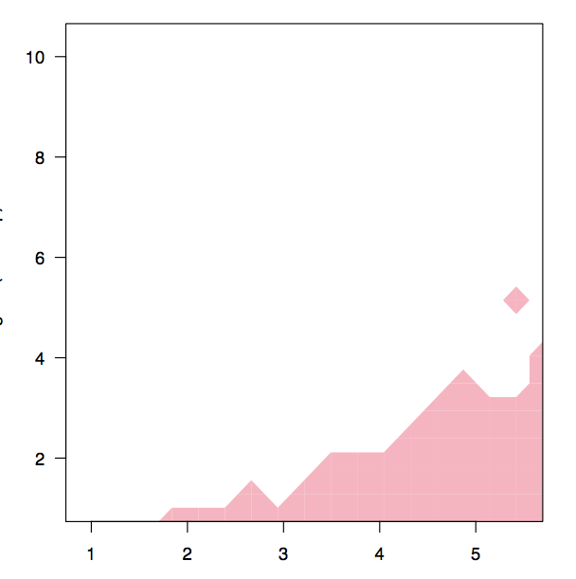


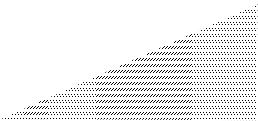

Slide 10
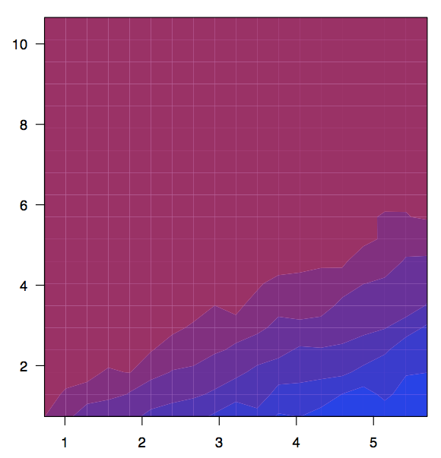
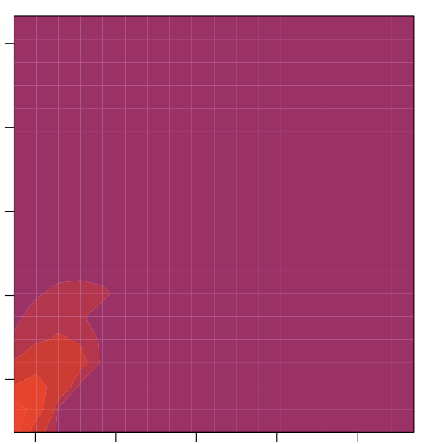
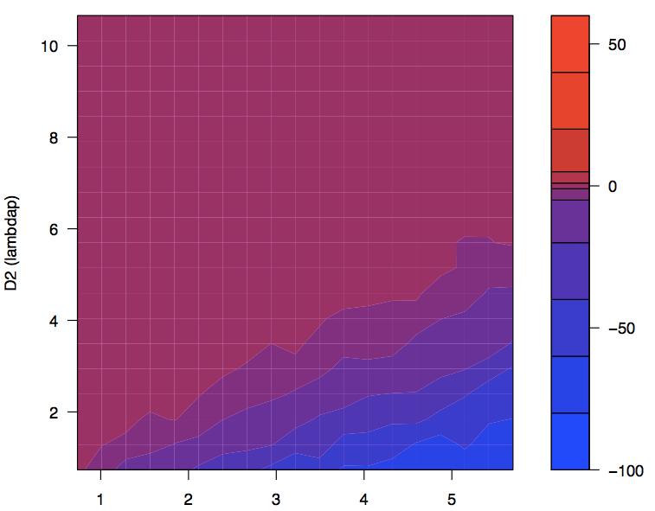
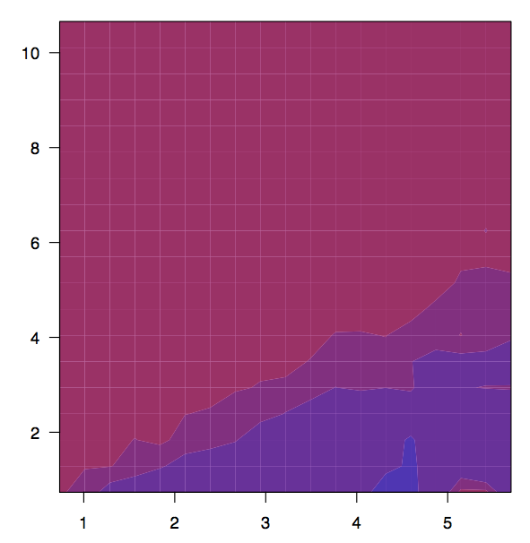

Slide 12
